Slide 1
Naïve Bayes Classifier ML ALGORITHM

Slide 2
MACHINE LEARNING METHODS
There is lot of overlapping between statistical modeling and machine learning. The Regression Models are used extensively in ML applications.
Naive Bayes Classifier
Support Vector Machines
K Nearest Neighbours Method (KNN)
Random Forest
Decision Trees
Neural Networks
Linear and Logistic Regression
Regression and Machine Learning Algorithms
Naive Bayes is a probabilistic classification technique

Slide 3
Naive Bayes Classifier
A naive Bayes classifier is a simple probabilistic classifier based on Bayes' theorem.
It can be used as an alternative method to Logistic Regression
It is particularly suited when the dimensionality of the inputs is high. Despite its simplicity, Naive Bayes can often outperform more sophisticated classification methods.

Slide 4
Conditional Probability
The conditional probability of an event B is the probability that the event
B will occur given the knowledge that an event A has already occurred.
This probability is written P(B|A).
If A and B are independent events then P(B|A)=P(B)
Example: An unbiased die with numbers 1-6 is tossed.
A: Getting a number greater than 1
B: Getting an even number
P(A)= 5/6 and P(B)=3/6=1/2
P(B|A)= 3/5 since sample space is reduced to 5 points given that A has already occurred.

Slide 5

Bayes Theorem
Where
P(A) is the prior probability or marginal probability of A.
P(A|B) is the conditional probability of A, given B.
P(B|A) is the conditional probability of B given A.
P(B) is the prior or marginal probability of B.

Slide 6
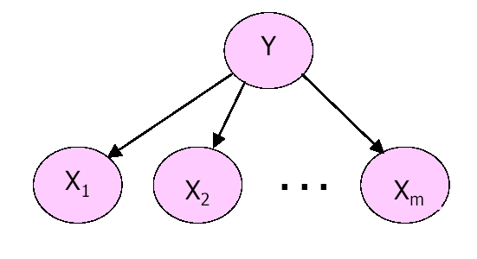
Naïve Bayes Framework
Y : Categorical Dependent Variable
Xi : Categorical/Continuous Independent Variable
Objective: To estimate Y given the values of Xi’s or
P(Y|X1 X2 ….Xm) using the Naïve Bayes Classifier.
Assumption: All Xi’s are conditionally independent of each other.

Slide 7
Example
Consider a simple example where dependent variable Y is binary variable and there are 2 independent
variables X1 and X2.
We classify Y = 1 as potential buyer of a certain product
Y = 0 otherwise
Let X1 denote age of the individual
X1 = 0 for age group 25-30 yrs.
= 1 for age group 31-40 yrs.
Let X2 denote gender
X2 = 0 if Gender=female
= 1 if Gender=male

Slide 8
Classification Rule
For the given values of age(X1)and gender(X2), we want to classify the customer as potential buyer or not.
Using Naïve Bayes Classifier we estimate following 2 conditional probabilities:
P(Y=0/X1=a1, X2=a2) and P(Y=1/X1=a1,X2=a2);
here a1 and a2 are values of X1 and X2 for a particular customer.
We classify Y = 0 if P(Y=0/X1=a1, X2=a2) > 0.5
OR Y = 1 if P(Y=1/X1=a1,X2=a2) > 0.5

Slide 9
Expected Output
Once the classification rule is applied the output can be shown as follows:
Case# | X1 | X2 | P(Y=1/X1,X2) | P(Y=0/X1,X2) | Y classified as
1 2 240 | 1 1 0 | 0 1 0 | 0.29 0.65 0.51 | 0.71 0.35 0.49 | 0 1 1

Slide 10
Advantages of the Method
Classification rule is simple to understand.
The method requires a small amount of training data to estimate the parameters necessary for classification.
The evaluation of the classifier is quick and easy.
The method can be a good alternative to logistic regression.

Slide 11
Naïve Bayes Method Few Comments
Assumption of conditional independence of the independent variables is highly impractical.
In case of continuous independent variables the density function must be known or assumed to be normal.
In case of categorical independent variables the probabilities cannot be calculated if the count in any conditional category is zero. For ex.: if there are no ‘Y=1’ in the age group 25-30 yrs. then P(X1=0/Y=1) = 0. In that case we replace 0 by 0.5/n (n = sample size) so that the probability expression does not reduce to zero. The function in R for Naive Bayes classifier performs Laplace smoothing to handle this problem.

Slide 12
Example
Employee churn model.
Independent variables are:
Gender
Experience Level (<3, 3-5 and >5 years)
Function (Marketing, Finance,Client Servicing)
Source (Internal or External)
Dependent variables is "status" (=1 if employee left within 18 months from
Joining date)

Slide 13
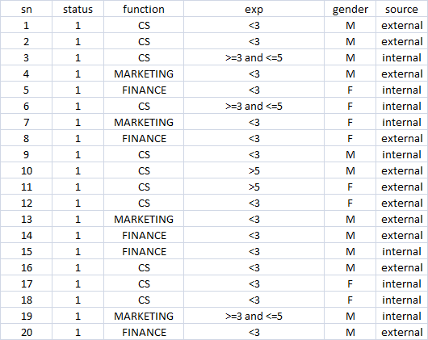
Data Snapshot

Slide 14
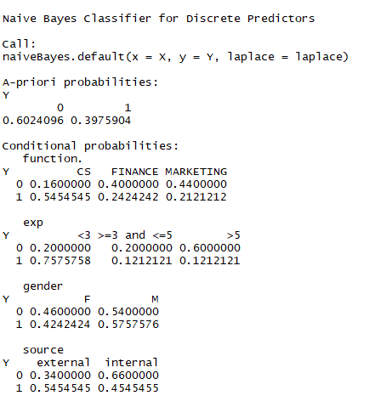
Naive Bayes Method in R
Employee Churn Data
empdata<- read.csv(file.choose())
library(e1071)
churnmodel<-naiveBayes(status~function. + exp + gender + source, data=empdata)
churnmodel
Output shows a list of tables, one for each predictor variable.
For each categorical variable the conditional probabilities for each class.
Eg. For gender, conditional probabilities for Females are 0.46 for no churn and 0.4242 for churn

Slide 15
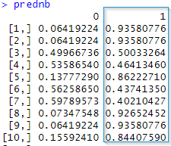
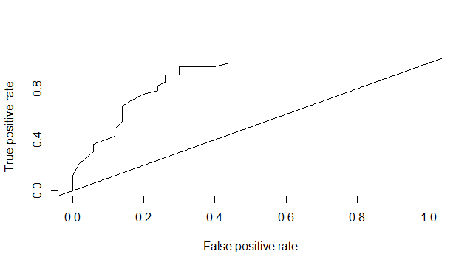
Naive Bayes Method in R…
Predicted Probabilities and ROC
# Predicted probabilities and ROC Curve
prednb<-predict(churnmodel,empdata,type='raw')
library(ROCR)
pred<-prediction(prednb[,2],empdata$status)
perf<-performance(pred,"tpr","fpr")
plot(perf)
abline(0,1)
# Area under ROC Curve in R (AUC)
auc<-performance(pred,"auc")
auc@y.values
[1] 0.8706061

Slide 16
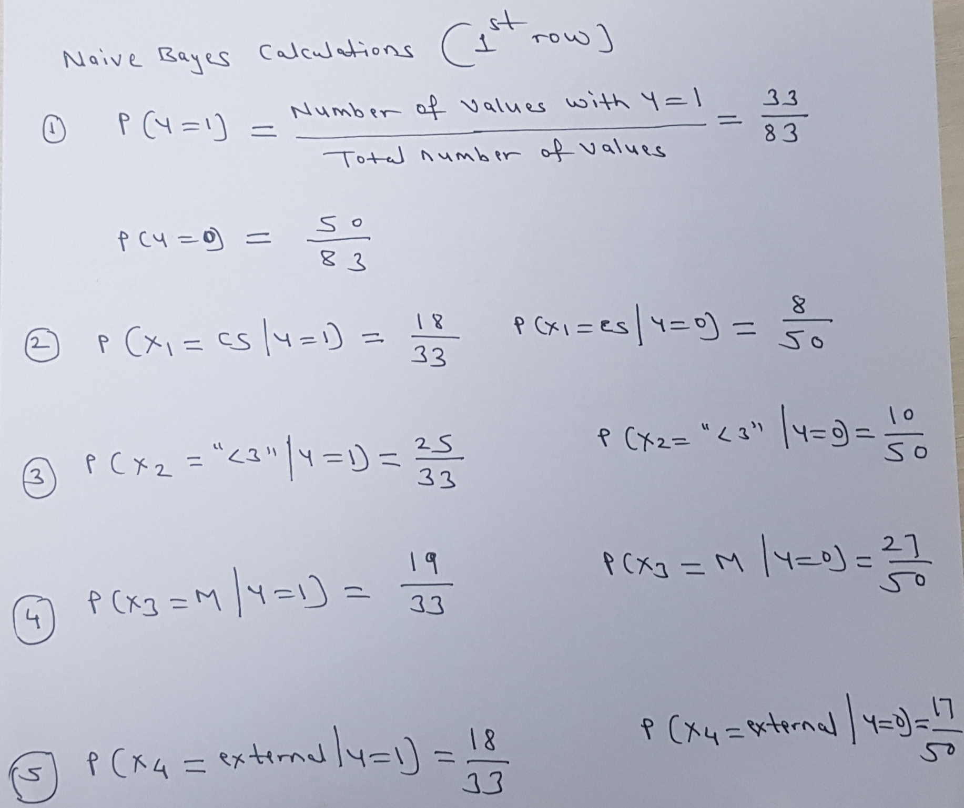
Predicted Probability for 1st Case

Slide 17
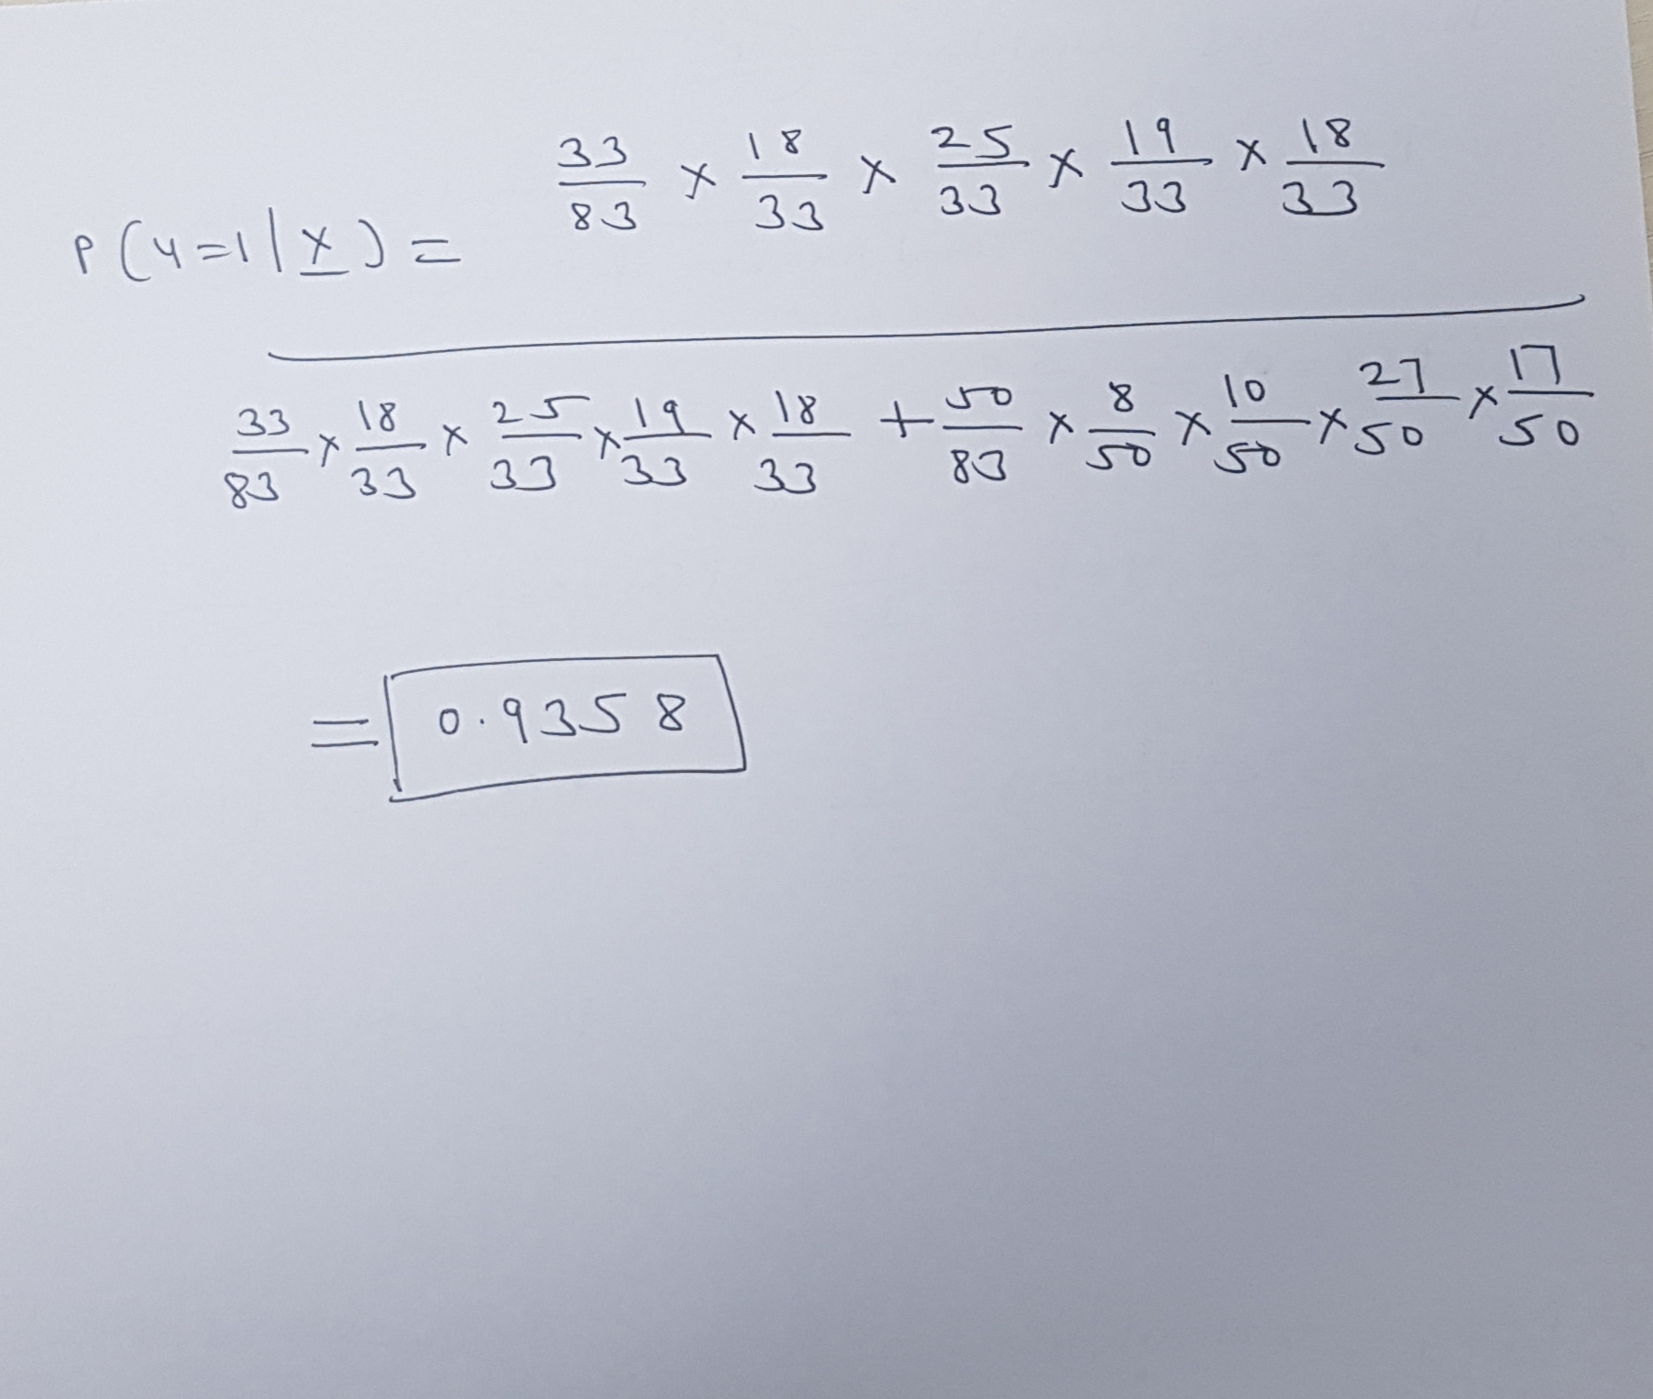
Predicted Probability for 1st Case

Slide 18
Case Study: Predicting Defaulters
Objective : To predict whether the customer applying for the loan will be a defaulter.
Predictors: Age group, Years at current address, Years at current employer,
Debt to Income Ratio, Credit Card Debts, Other Debts.
Dependent Variable: Defaulter (=1 if defaulter ,0 o.w.)
Sample Size:700

Slide 19
Snapshot of the Data
AGE | EMPLOY | ADDRESS | DEBTINC | CREDDEBT | OTHDEBT | DEFAULTER
3 | 17 | 12 | 9.30 | 11.36 | 5.01 | 1
1 | 10 | 6 | 17.30 | 1.36 | 4.00 | 0
2 | 15 | 14 | 5.50 | 0.86 | 2.17 | 0
3 | 15 | 14 | 2.90 | 2.66 | 0.82 | 0
1 | 2 | 0 | 17.30 | 1.79 | 3.06 | 1
3 | 5 | 5 | 10.20 | 0.39 | 2.16 | 0
2 | 20 | 9 | 30.60 | 3.83 | 16.67 | 0
3 | 12 | 11 | 3.60 | 0.13 | 1.24 | 0
1 | 3 | 4 | 24.40 | 1.36 | 3.28 | 1
2 | 0 | 13 | 19.70 | 2.78 | 2.15 | 0
1 | 0 | 1 | 1.70 | 0.18 | 0.09 | 0
1 | 4 | 0 | 5.20 | 0.25 | 0.94 | 0
Age groups: 1 ( <28 years), 2(28-40 years), 3 (>40 years)

Slide 20
Case Study: Predicting Defaulters…
DEFAULTER
(YES OR NO)
AGE
EMPLOY
(-)
ADDRESS
(-)
DEBTINC
(+)
OTHDEBT
(+)
CREDDEBT
(+)

Slide 21
Logistic Regression in R
bankloan$AGE<-as.factor(bankloan$AGE)
riskmodel<-glm(DEFAULTER~AGE+EMPLOY+ADDRESS+DEBTINC+CREDDEBT+OTHDEBT,family=binomial,data=bankloan)
summary(riskmodel)
__________________________________________________________________
Coefficients:
Estimate Std. Error z value Pr(>|z|)
(Intercept) -0.78821 0.26407 -2.985 0.00284 **
AGE2 0.25202 0.26651 0.946 0.34433
AGE3 0.62707 0.36056 1.739 0.08201 .
EMPLOY -0.26172 0.03188 -8.211 < 2e-16 ***
ADDRESS -0.09964 0.02234 -4.459 8.22e-06 ***
DEBTINC 0.08506 0.02212 3.845 0.00012 ***
CREDDEBT 0.56336 0.08877 6.347 2.20e-10 ***
OTHDEBT 0.02315 0.05709 0.405 0.68517
GLM: Generalized Linear Models
EMPLOY,ADDRESS,DEBTINC and CREDDEBT are statistically significant.

Slide 22
Excluding 'AGE' and 'OTHDEBT'
riskmodel<-glm(DEFAULTER~EMPLOY+ADDRESS+DEBTINC+CREDDEBT,
family=binomial,data=bankloan)
summary(riskmodel)
__________________________________________________________________
Estimate Std. Error z value Pr(>|z|)
(Intercept) -0.79107 0.25154 -3.145 0.00166 **
EMPLOY -0.24258 0.02806 -8.646 < 2e-16 ***
ADDRESS -0.08122 0.01960 -4.144 3.41e-05 ***
DEBTINC 0.08827 0.01854 4.760 1.93e-06 ***
CREDDEBT 0.57290 0.08725 6.566 5.17e-11 ***
EMPLOY,ADDRESS,DEBTINC and CREDDEBT are statistically significant.

Slide 23
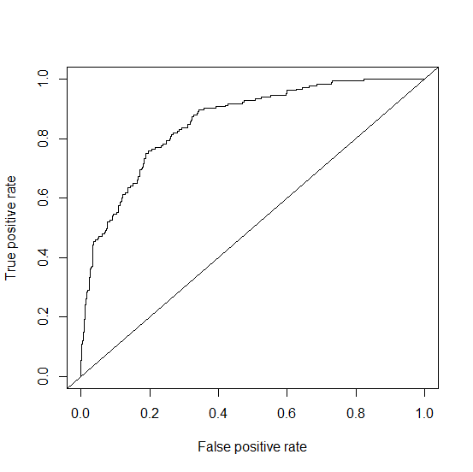
ROC Curve in R
library(ROCR)
bankloan$predprob<-fitted(riskmodel)
pred<-prediction(bankloan$predprob,bankloan$DEFAULTER)
perf<-performance(pred,"tpr","fpr")
plot(perf)
abline(0,1)

Slide 24
Area Under ROC Curve in R
auc<-performance(pred,"auc")
auc@y.values
0.8558096
0.8556193
0.8556193

Slide 25
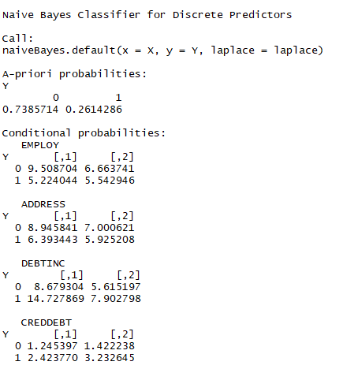
Naive Bayes Method in R…
library(e1071)
riskmodel2<-naiveBayes(DEFAULTER~EMPLOY + ADDRESS+ DEBTINC + CREDDEBT,data=bankloan)
riskmodel2
Output shows a list of tables, one for each predictor variable.
For each categorical variable the conditional probabilities for each class.
For each numeric variable, for each target class, mean and standard deviation
Eg. For EMPLOY, mean for churn status = 0 is 9.58 and sd is 6.66

Slide 26
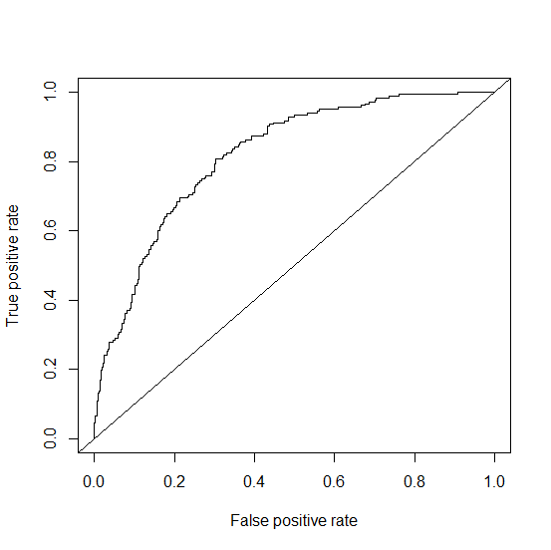
Naive Bayes Method in R…
Predicted Probabilities and ROC
# Predicted probabilities and ROC Curve
prednb<-predict(riskmodel2,bankloan,type='raw')
library(ROCR)
pred<-prediction(prednb[,2],bankloan$DEFAULTER)
perf<-performance(pred,"tpr","fpr")
plot(perf)
abline(0,1)
# Area under ROC Curve in R (AUC)
auc<-performance(pred,"auc")
auc@y.values
[1] 0.8188266

Slide 27
Naive Bayes Method in R…
Confusion Matrix
# Generating a Confusion Matrix
library(caret)
prednb<-predict(riskmodel2,bankloan,type='raw')
bankloan$predY<-ifelse(prednb[,2]>0.25,1,0)
confusionMatrix(factor(bankloan$predY),factor(bankloan$DEFAULTER))
Confusion Matrix and Statistics
Reference
Prediction 0 1
0 444 83
1 73 100
Accuracy : 0.7771
Try different cut-off values to get best model.

Slide 28
Read More ….

Slide 29
Naïve Bayes Method in R… Laplace Smoothing
If a given class and feature value never occur together in the training data, then the frequency-based probability estimate will be zero.
This is problematic because it will wipe out all information in the other probabilities when they are multiplied.
Therefore, it is often desirable to incorporate a small-sample correction, called pseudo-count, in all probability estimates such that no probability is ever set to be exactly zero.
This way of regularising naive Bayes is called Laplace Smoothing when the pseudo count is one, and Lidstone Smoothing in the general case.
model<-naiveBayes(Y~X1 + X2+ X3,data=…, laplace=2)
Note: naiveBayes in R replace ‘0’ probability by ‘0.001’ for out of sample prediction.

Slide 30


Naïve Bayes Method in R… Laplace Smoothing
$$P\left(x=x_{i} \right| y=y_{j})={f_{i}}/{N_{j}}$$
This prob will be 0 if numerator count ($f_{i}$) is 0
Laplace smoothing will replace this probability with a value obtained by the formula:
where
$α$ : Smoothing Parameter
$N$: Number of observations for $y_{j}$
$d$ : Number of classes of $x_{i}$
$$\hat{θ}i=\frac{f_{i}+α}{N+αd}$$

Slide 31
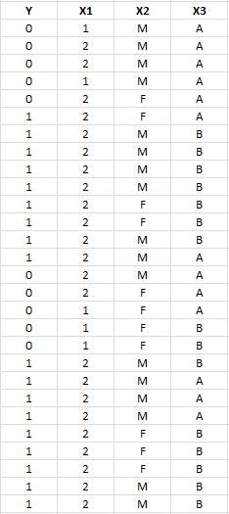
Naïve Bayes Method in R… Laplace Smoothing
data1<-read.csv(file.choose(),header=T)
head(data1)
data1$X1<-as.factor(data1$X1) #X1 is a factor variable
Variable X1 is a factor with two levels, 1 & 2. There is no observation in the data with X1 =1 when the dependent variable Y =1. Hence, P(X1=1|Y=1) =0. We thus introduce smoothing, to avoid loss of information.

Slide 32
Naïve Bayes Method in R… Laplace Smoothing
# First run the default Naive Bayes model
model<-naiveBayes(Y~X1+X2+X3,data=data1)
model # Check model output, conditional probability for Y=1, X1=1 is 0.0
A-priori probabilities:
Y
0 1
0.3571429 0.6428571
Conditional probabilities:
X1
Y 1 2
0. 0.5 0.5
1. 0.0 1.0
……
laplacemodel<-naiveBayes(Y~X1+X2+X3,data=data1,laplace=2)
laplace= tells R the value of pseudo-count to be used to smoothen the model.
There is no rule for choosing the appropriate pseudo-count. The number should be low, but not so low that the resulting probability is almost 0.

Slide 33
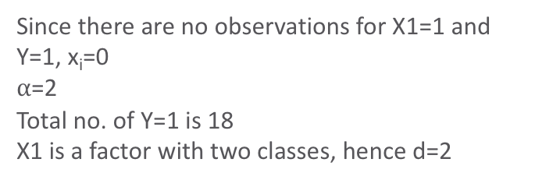
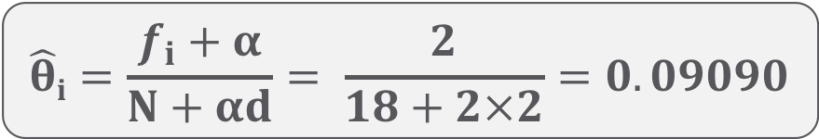
Naïve Bayes Method in R… Laplace Smoothing
laplacemodel
Naive Bayes Classifier for Discrete Predictors
Call: naiveBayes.default(x = X, y = Y, laplace = laplace)
A-priori probabilities:
Y
0 1
0.3571429 0.6428571
Conditional probabilities:
X1
Y 1 2
0 0.50000000 0.50000000
1 0.09090909 0.90909091
X2
Y F M
0 0.5000000 0.5000000
1 0.3636364 0.6363636
X3
Y A B
0 0.7142857 0.2857143
1 0.3181818 0.6818182
$$\hat{θ}i=\frac{f_{i}+α}{N+αd}= \frac{2}{18+2×2}=0.09090$$
Since there are no observations for X1=1 and Y=1, x_{i}=0
$α$=2
Total no. of Y=1 is 18
X1 is a factor with two classes, hence d=2

Slide 34
THANK YOU!!

